Slide 1

Detection and Prevention of DoS Attacks Using Machine Learning Techniques
ICT 607 – Artificial Intelligence for Cyber Security
Group 16
Members:
Jyothi Ravipati – 34784275
E.H. Dinuka Sandaruwan – 35048058
Van Sanh VU – 34900798
Muhammad Danyal Khan – 34721903
Members:
Jyothi Ravipati – 34784275
E.H. Dinuka Sandaruwan – 35048058
Van Sanh VU – 34900798
Muhammad Danyal Khan – 34721903

Slide 2
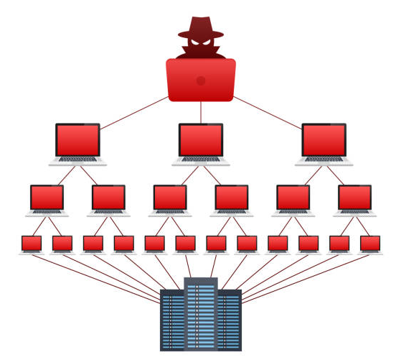
Executive Summary
What?
A Denial-of-Service (DoS) attack is a cyberattack that floods a system or network with excessive traffic, making it unavailable to legitimate users.
Why is it a Critical Problem in cybersecurity?
DoS attacks disrupt business operations, cause financial loss, and can expose vulnerabilities in critical infrastructure, making them a persistent threat.
Traditional systems struggle with new or complex threats.
ML offers smarter, data-driven intrusion detection.
Objective
Apply ML to detect and classify DoS attacks using the UNSW-NB15 dataset for enhanced intrusion detection.
Danyal Khan
1

Slide 3
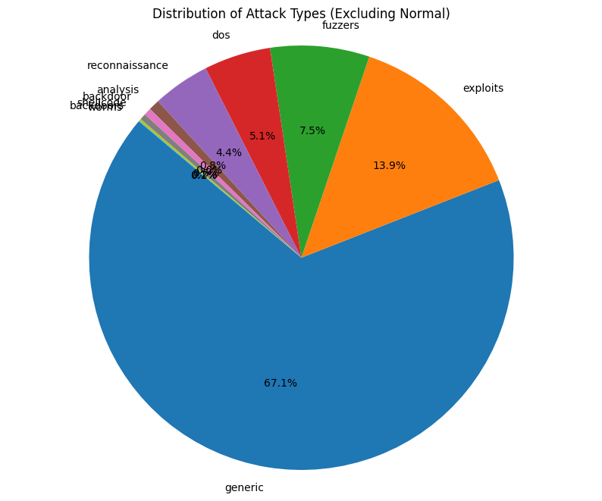
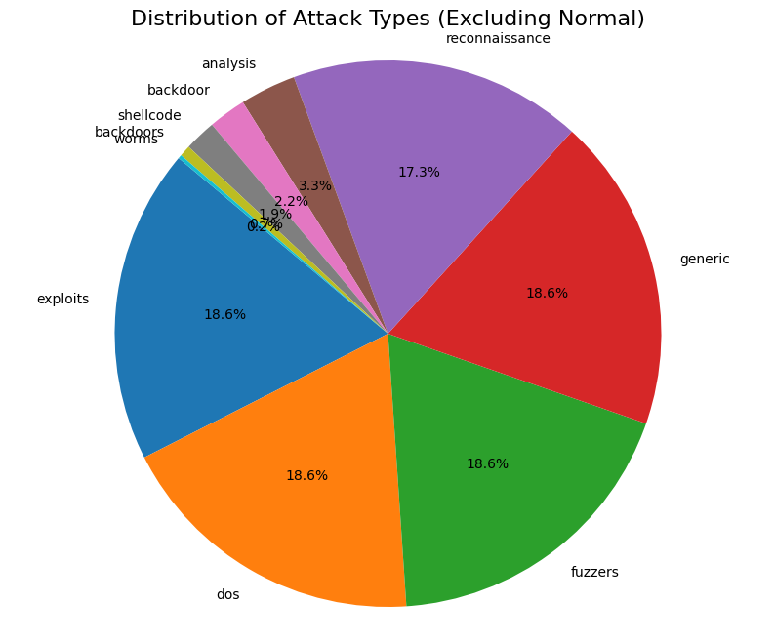
Dataset Overview
UNSW-NB15: Public cybersecurity dataset with real + synthetic traffic
2.5M records, 49 features, 10 attack classes (including DoS)
Distribution of Attack Types
Distribution of Attack Types After Balancing
Danyal Khan
2

Slide 4
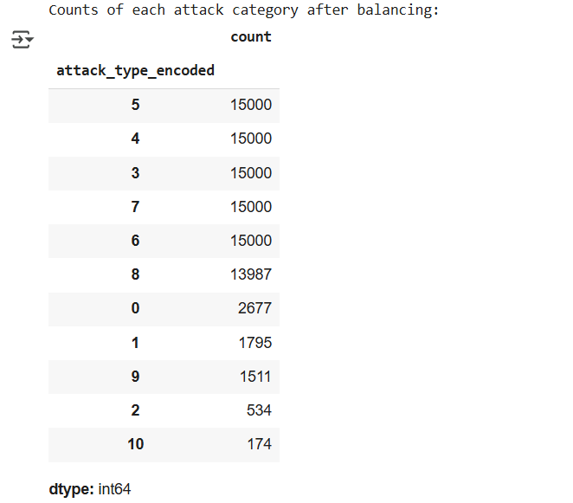
Data Preprocessing
Steps:
Raw CSV merging
Missing value handling (attack_cat -> ‘normal’, others -> 0)
Duplicate removal (550k rows)
Label encoding & feature type correction
Class balancing (15,000 samples/class)
Dinuka
3

Slide 5
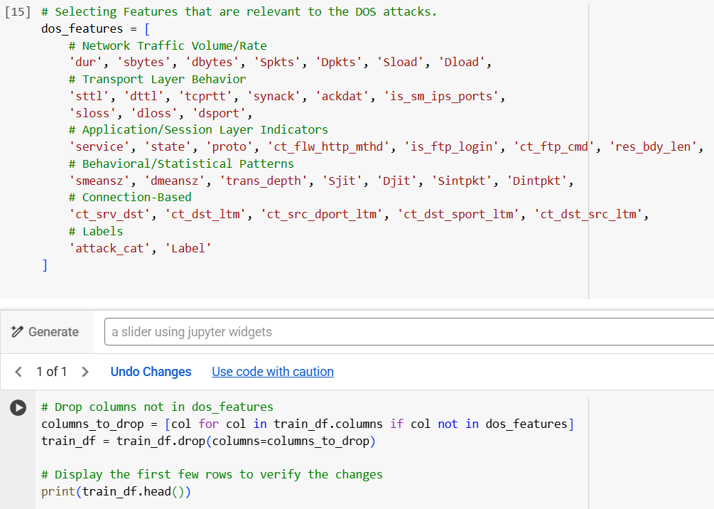
Feature Engineering
Selected ~34 most relevant features for DoS detection
Removed irrelevant fields (srcip, sport, etc.)
Focus on: dur, sbytes, Spkts, state, tcprtt, etc.
Notebook Access: https://colab.research.google.com/drive/1l8I405PbeKM4Z7574LZFapjgwoEJbiSY
Feature Selection and Dropping Irrelevant Attributes for DoS Detection
Dinuka
4

Slide 6
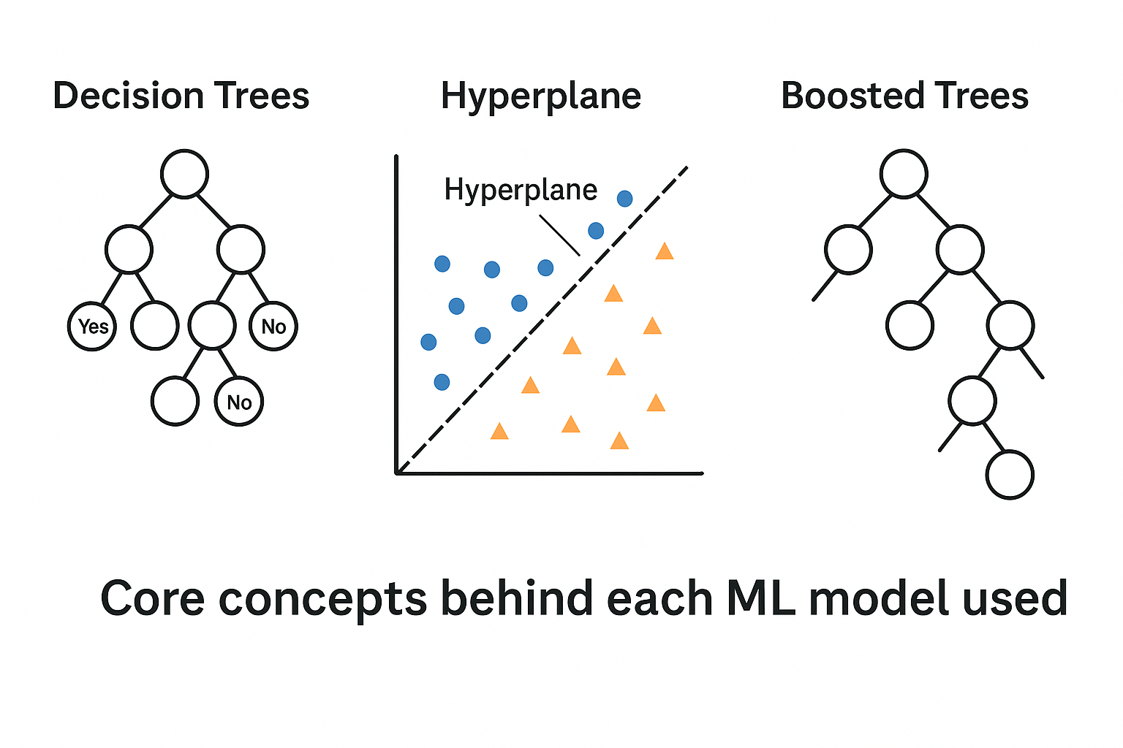
ML Models Used
Random Forest
Support Vector Machine (SVM)
Extreme Radiant Boosting (XGBoost)
Why These Models?
Model | Strengths | Suitability
Random Forest | Fast, interpretable, robust | Best for imbalanced data
SVM | Effective in high-dimensional spaces | Works well with clear margins
XGBoost | High accuracy, handles noise | Best overall performer
Jyothi Khan
5

Slide 7
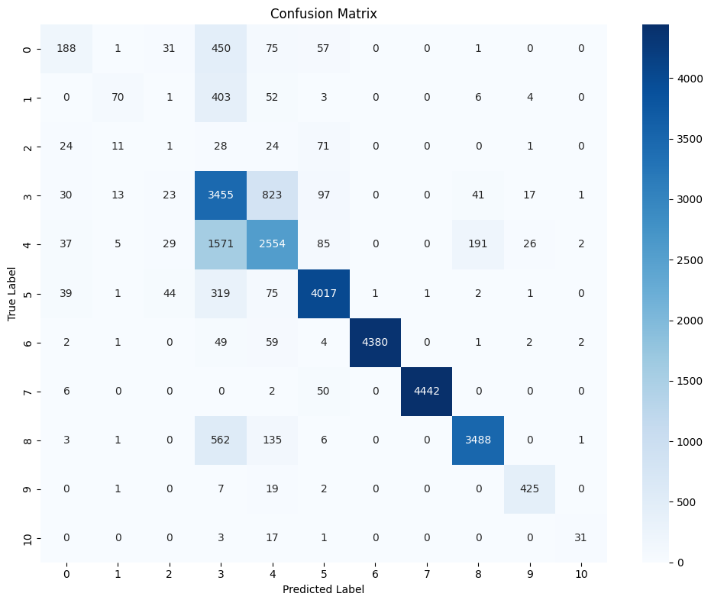
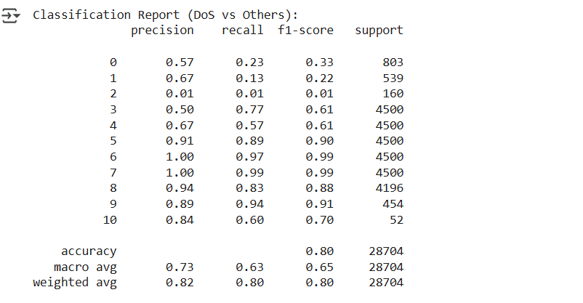
Random Forest Results
Confusion Matrix
Classification Report
Accuracy: 80%
DoS Detection: Precision 0.50, Recall 0.77, F1 0.61
Jyothi Khan
6

Slide 8

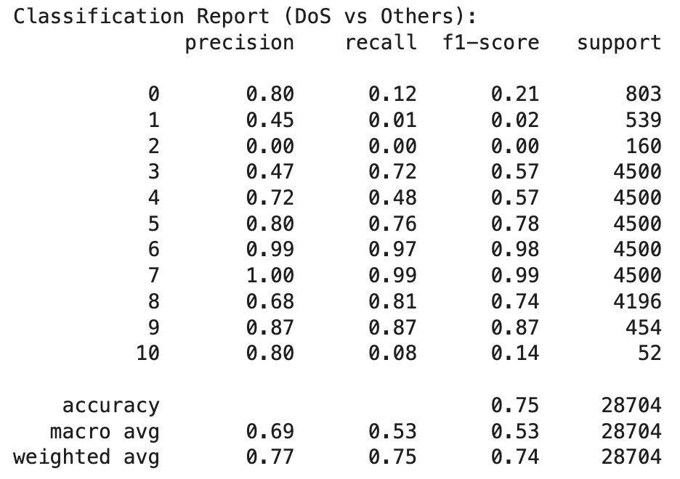
SVM Results
Confusion Matrix
Classification Report
Accuracy: 75%
DoS Detection: Precision 0.47, Recall 0.72, F1 0.57
Jyothi
7

Slide 9

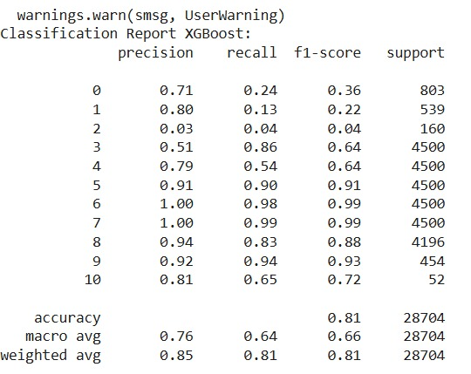
XGBoost Results
Confusion Matrix
Classification Report
Accuracy: 81% (best performer)
DoS Detection: Precision 0.51, Recall 0.86, F1 0.64
Notebook Access: https://colab.research.google.com/drive/1l8I405PbeKM4Z7574LZFapjgwoEJbiSY
Jyothi
8

Slide 10
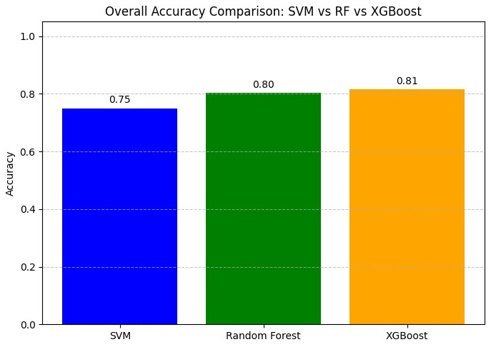
Performance Comparison
Accuracy, Precision, Recall, F1 for all models
Insight: XGBoost > RF > SVM in DoS classification
Van Sanh
9

Slide 11
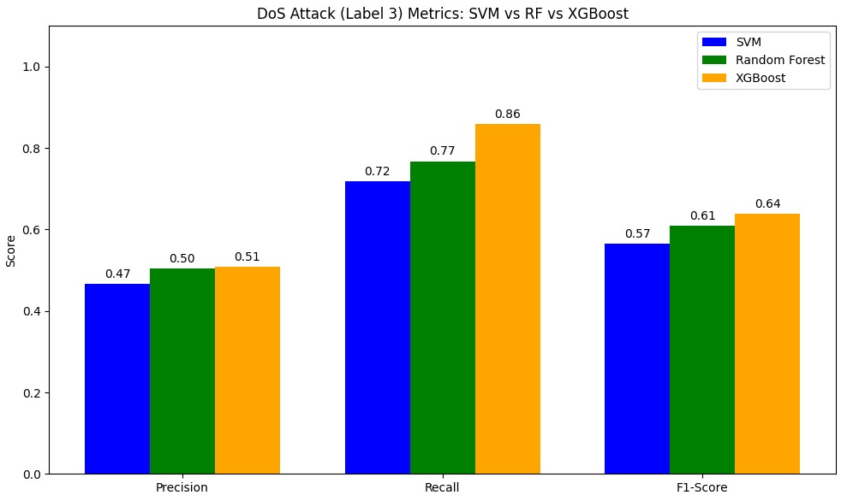
Achievements
Completed full ML pipeline from data ingestion to evaluation
Balanced class distribution successfully
Interpretable models with strong detection rates
Model | Accuracy | Macro F1 | Weighted F1
XGBoost | 81% | 0.68 | 0.82
Random Forest | 80% | 0.65 | 0.80
SVM | 75% | 0.53 | 0.74
Summary of Key Metrics
Van Sanh
10

Slide 12
Limitations & Future Work
Limitations:
SVM training time
Rare class imbalance
Future Work:
Hyperparameter tuning (e.g., GridSearchCV)
Try real-time or streaming datasets
Explore LightGBM, Deep Learning
Van Sanh
11

Slide 13
Conclusion
ML models are effective for intrusion detection
XGBoost showed the best results overall
Random Forest still reliable for balanced speed/accuracy
Importance of data preprocessing in cybersecurity ML
Van Sanh
12

Slide 14
References
Moustafa, N., & Slay, J. (2015). UNSW-NB15: A comprehensive data set for network intrusion detection systems (UNSW-NB15 network data set). 2015 Military Communications and Information Systems Conference (MilCIS), 1–6. https://doi.org/10.1109/MilCIS.2015.7348942
Sarker, I. H. (2020). Cybersecurity data science: An overview from a machine learning perspective. Journal of Big Data, 7(1), 1–29. https://doi.org/10.1186/s40537-020-00318-5
Alazab, M. A. (2021). Machine learning for cybersecurity: A comprehensive review. IEEE Access, 9, 86144–86181.
Kumar, N. T. (2020). Denial-of-service attacks and their mitigation techniques: A review. International Journal of Computer Sciences and Engineering, 8(1), 15–24.
Verma, A., & Ranga, V. (2020). Performance analysis of IDS using supervised machine learning algorithms with feature selection methods on UNSW-NB15 dataset. ICT Express, 6(4), 325–331. https://doi.org/10.1016/j.icte.2020.09.002
Buda, M., Maki, A., & Mazurowski, M. A. (2018). A systematic study of the class imbalance problem in convolutional neural networks. Neural Networks, 106, 249–259. https://doi.org/10.1016/j.neunet.2018.07.011
Aljawarneh, S., Aldwairi, M., & Yassein, M. B. (2018). Anomaly-based intrusion detection system through feature selection analysis and building hybrid efficient model. Journal of Computational Science, 25, 152–160. https://doi.org/10.1016/j.jocs.2017.03.006
Shone, N., Ngoc, T. N., Phai, V. D., & Shi, Q. (2018). A deep learning approach to network intrusion detection. IEEE Access, 6, 21954–21961. https://ieeexplore.ieee.org/document/8264962
OpenAI. (2025). ChatGPT. Retrieved from ChatGP-4: https://chatgpt.com/c/67da3e3a-7b94-800f-ab3a-a48c2eb43701
13

Slide 15

Thank you
Any Questions??

